Slide 1
Unit 6: What time is it?
Grade 3
Lesson Four: phonics

Slide 2
LET’S sing

Slide 8
Listen point and repeat

Slide 10
Listen and chant

Slide 12
Read the chant again.
Circle the sounds
sm, st, and sk.

Slide 13
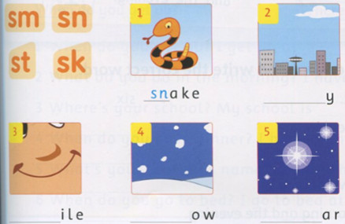
Listen and complete the words.
sk
sm
sn
st

Slide 14
Unit 6: What time is it?
Grade 3
Lesson Five: Skills time!

Slide 15
Look at the pictures.Say what the girl and her mom do.

Slide 16
Listen and point

Slide 18
READ AGAIN

Slide 19
Read again.
Circle the false word and write the correct word.
1. Linh gets up at eight o'clock. ___six___
2. She goes to school in the evening. ___
3. Linh's mom is a teacher. ___
4. Linh's mom goes home at two o'clock. ______
5. Linh sees her mom in the morning and the evening. ___
morning
doctor
five
afternoon

Slide 20
Unit 6: What time is it?
Grade 3
Lesson Six

Slide 21
LISTEN AND DRAW THE TIME

Slide 22
LISTEN AND DRAW THE TIME

Slide 23
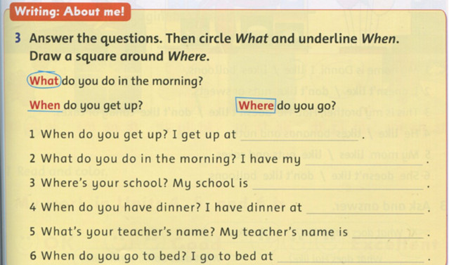
six o’clock
go to school
in Phu Hoa Dong
seven o’clock
.......
ten o’clock

Slide 24
Tasks: Worktime!
Finish the works in your workbook!
page 43, 44, 45

Slide 25
Goodbye~!

